Slide 1
Android Bluetooth Stack
BinhHT7

Slide 2
Content
Bluetooth Overview
Android Bluetooth Stack

Slide 3
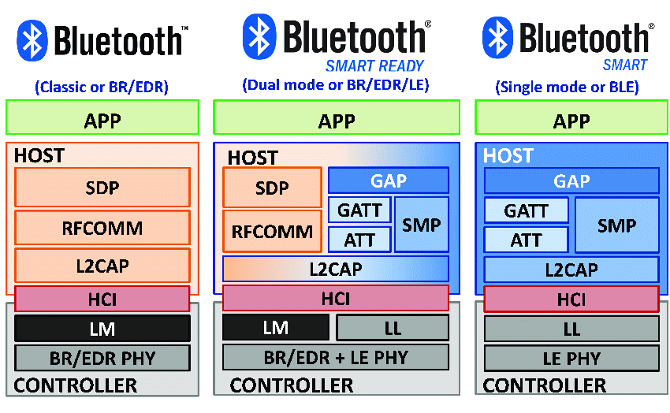
1. Bluetooth Overview

Slide 4
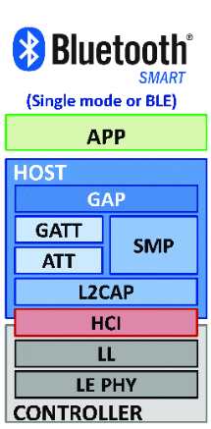
1. Bluetooth Overview
GAP: defines procedures concerned with device discovery and establishing connections between two devices
GATT: defines higher-level data types based on the attributes held in the attribute table.
ATT: contains a handle, a Universally Unique Identifier (UUID), a value and a set of permissions
SMP: A protocol used during the execution of security procedures such as pairing.
L2CAP: responsible for protocol multiplexing, flow control, and segmentation and reassembly of service data units (SDUs).
HCI: defines a standardized interface via which a host can issue commands to the controller and a controller can communicate with the host.

Slide 5
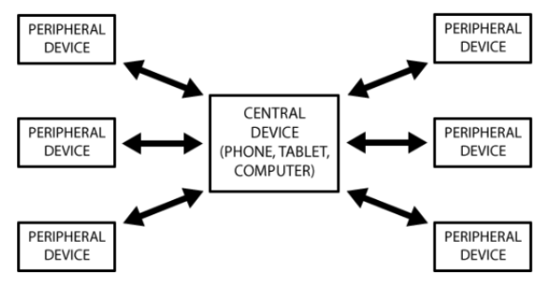
1. Bluetooth Overview
Bluetooth Device Roles:
Peripheral
Central

Slide 6
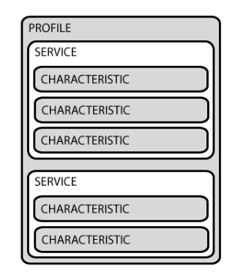
1. Bluetooth Overview
Peripheral: usually acts as a server
Characteristic, composed of:
A single value (int, float, string)
Many descriptors
Service: group of related characteristics
Profile: group of services
Identified using UUIDs

Slide 7
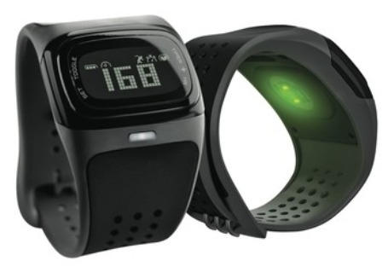
1. Bluetooth Overview
Example:
Profile: “Heart Rate”
Services:
“Heart Rate”
Characteristics:
“Current Heart Rate” (read/subscribe)
“Settings” (read/write)

Slide 8
1. Bluetooth Overview
Central: usually acts as a client
Can connect to up to 7 BLE servers simultaneously
Reads/writes/subscribes to characteristics

Slide 9
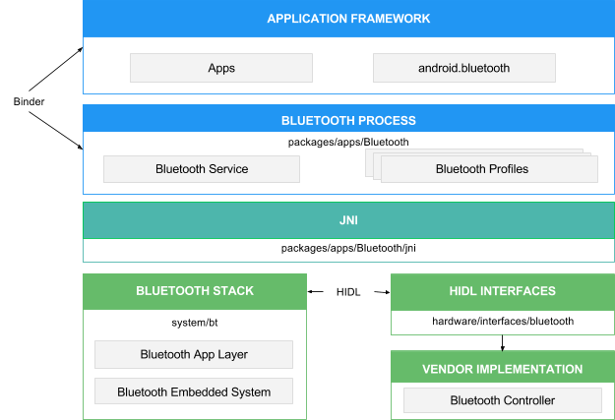
2. Android Bluetooth Stack

Slide 10
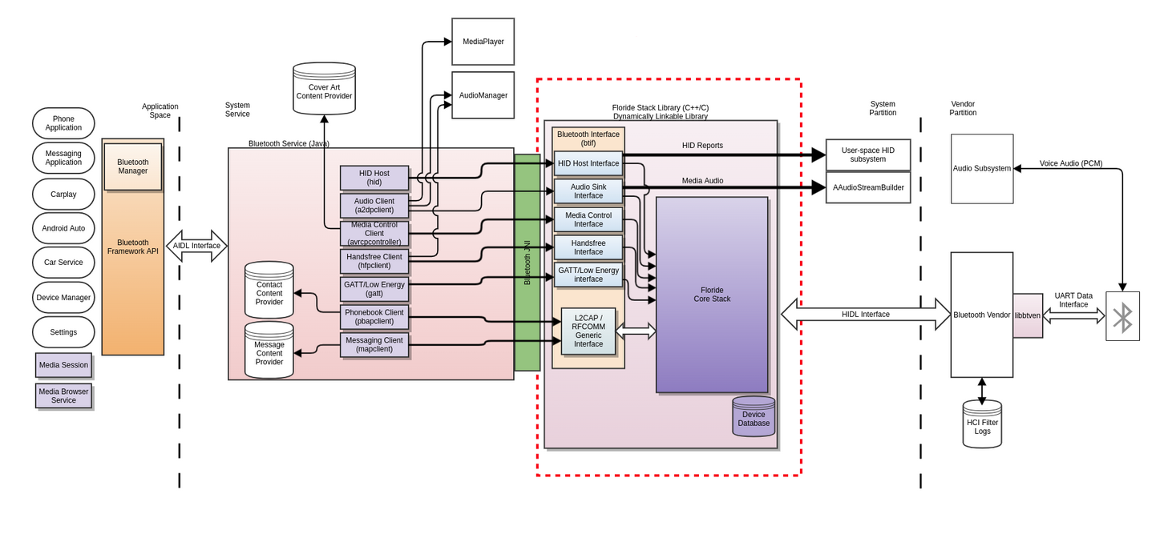
2. Android Bluetooth Stack

Slide 11
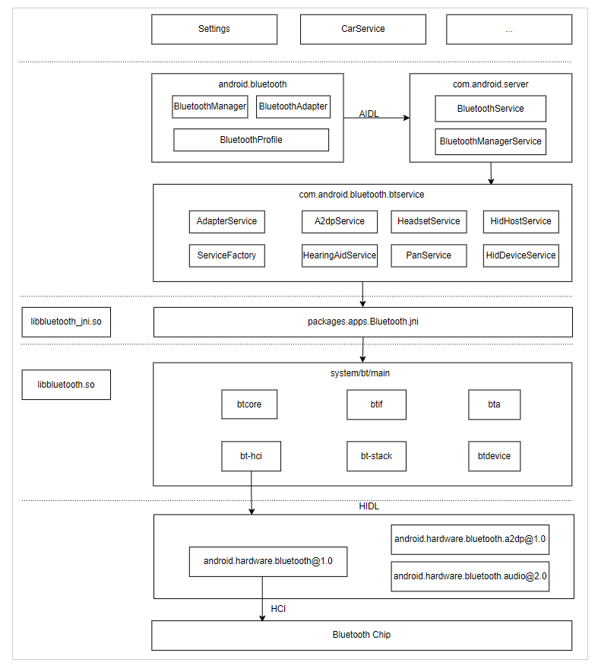
2. Android Bluetooth Stack

Slide 12
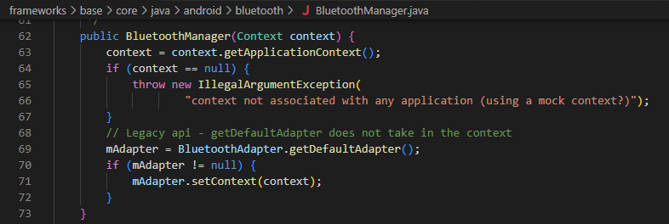
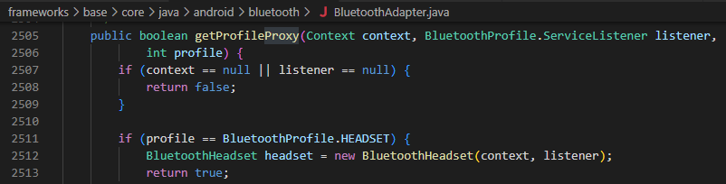
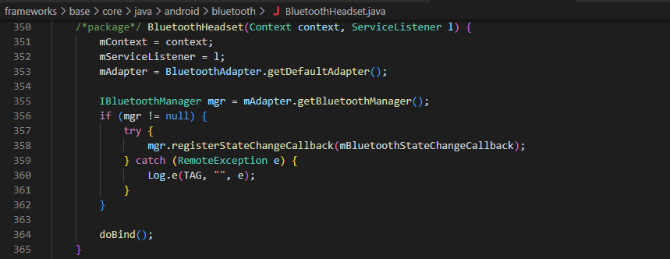
2. Android Bluetooth Stack
BluetoothManager
BluetoothAdapter
BluetoothProfile

Slide 13

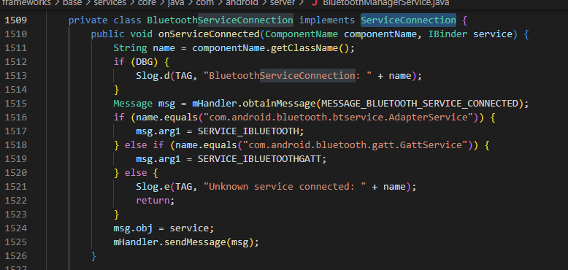
2. Android Bluetooth Stack
BluetoothService
BluetoothManagerService

Slide 14
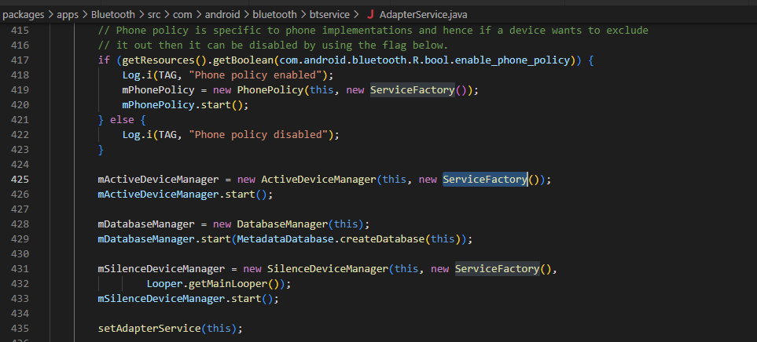
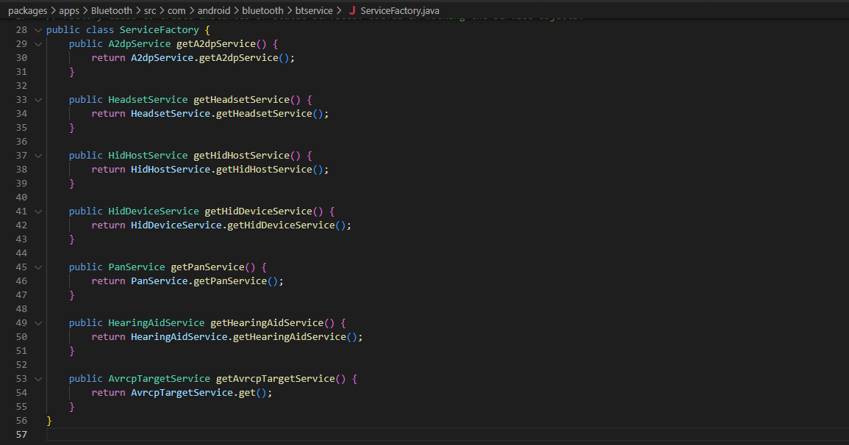
2. Android Bluetooth Stack
AdapterService
ServiceFactory

Slide 15
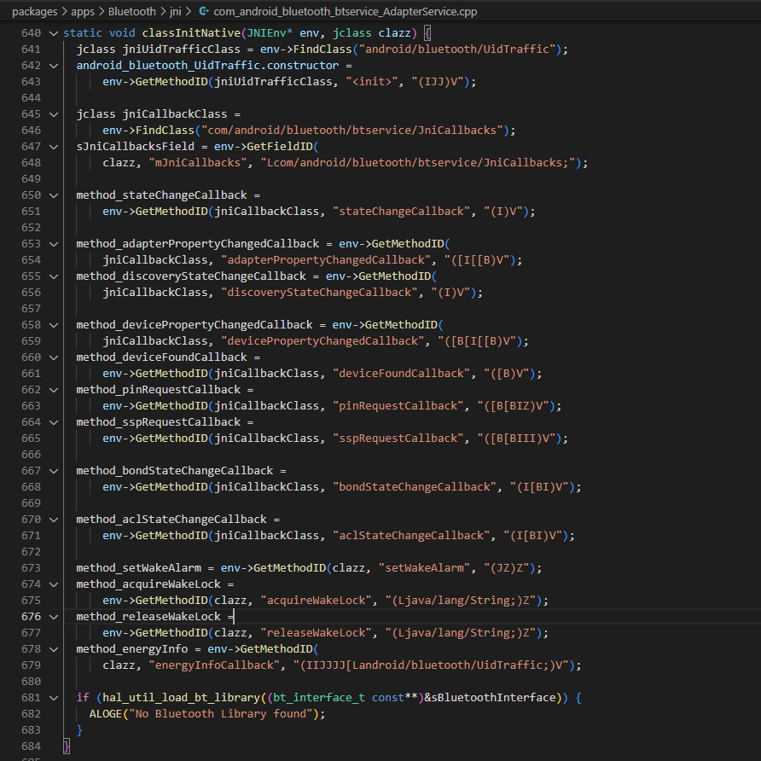
2. Android Bluetooth Stack
JNI

Slide 16
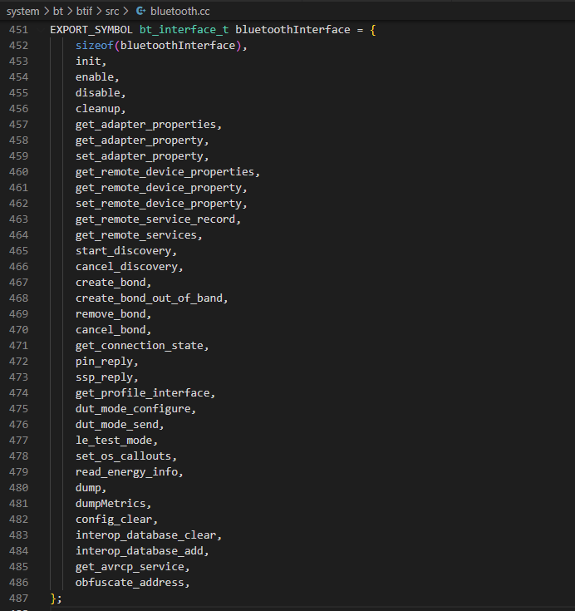
2. Android Bluetooth Stack
BTIF

Slide 17
References
https://source.android.com/docs/core/connect/bluetooth
https://techjournalsite.home.blog/tag/bluetooth/
https://learn.adafruit.com/introduction-to-bluetooth-low-energy/introduction

